Slide 1
Vexing VBA
Lesson 2.2

Slide 2

Today, this is you.
Notes:
shutterstock_1128769874

Slide 3
Refresher

Slide 4

Q
What does “coding requires thinking procedurally” mean?

Slide 5

How a Computer Thinks
(Procedurally)
Every software development problem begins with a complex and abstract real-world need.
Notes:
shutterstock_1077594281

Slide 6
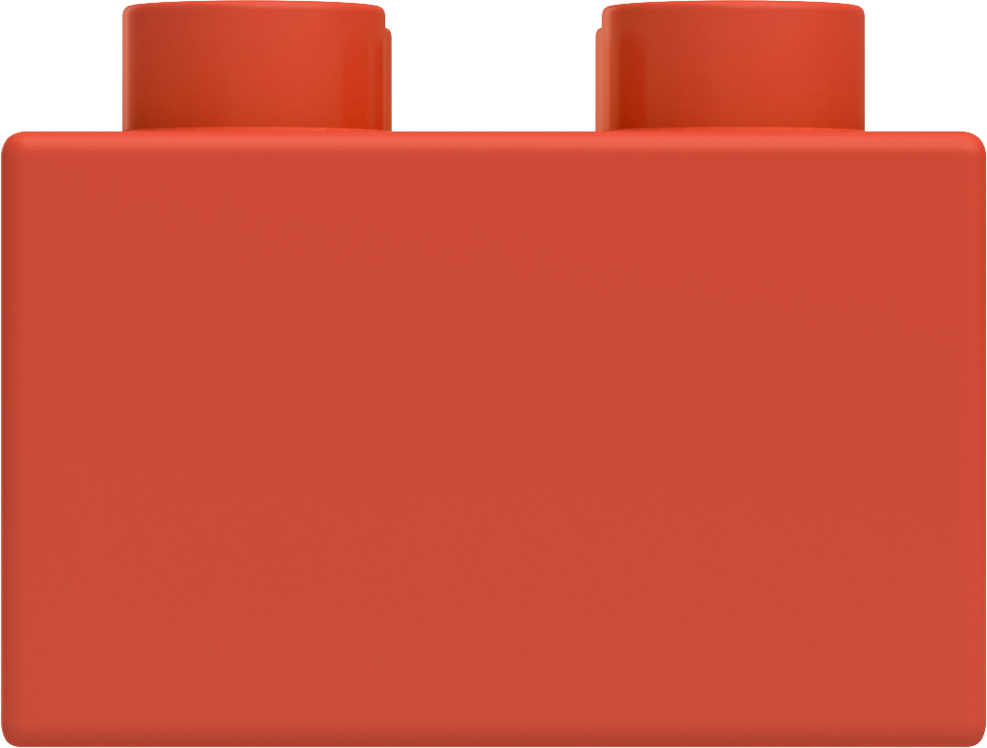
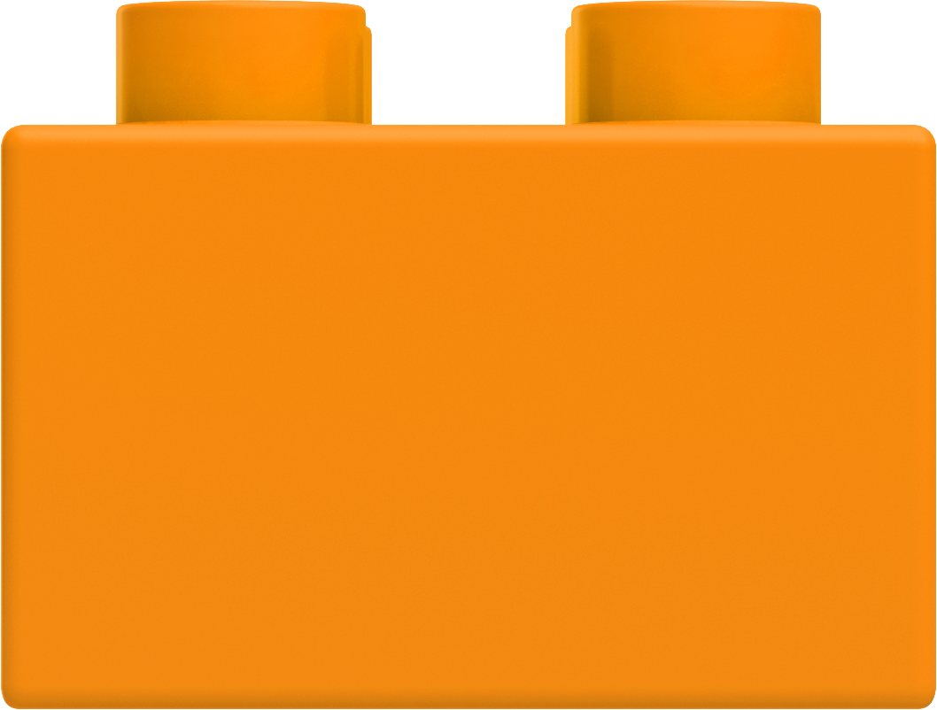
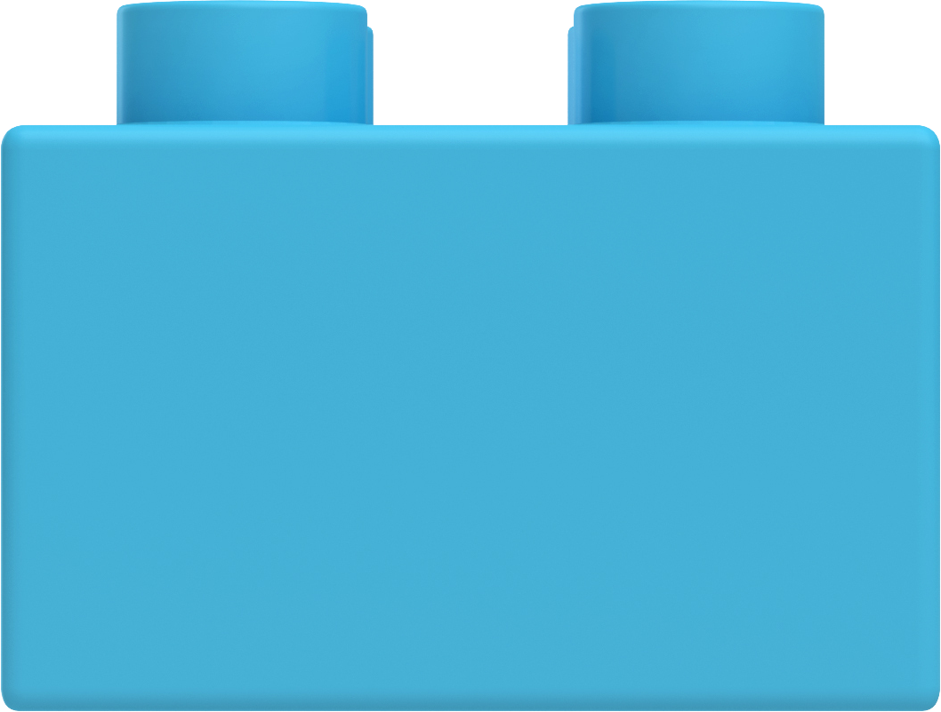
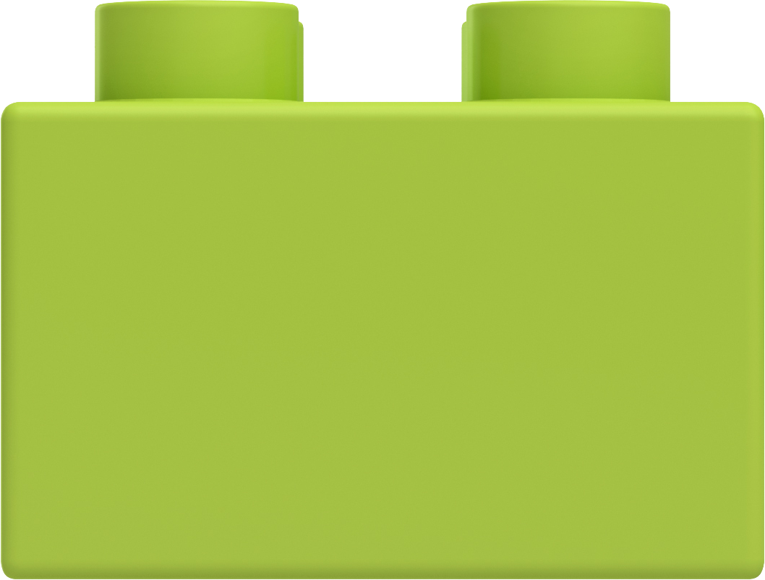
How a Computer Thinks (Procedurally)
In order for a computer to interpret things, a real-world problem must be broken down into a set of procedural steps.
Complex Real-World Problem
STEP
1
STEP
2
STEP
3
STEP
4

Slide 7
How Code Is Written (Procedurally)
Code (JavaScript)
1 | // STEP 1
2 | // --------------------------------
3 | var thingamagig = 500;
4 | var doodad = 200;
5
6 | // STEP 2
7 | // --------------------------------
8 | var combindedThing = thingamagig + doodad
9
10 | // STEP 3
11 | // --------------------------------
12 | runContraption(combindedThing);
13
14 | // STEP 4
15 | // --------------------------------
16 | resetContraption();
STEP 1
STEP 2
STEP 3
STEP 4

Slide 8
Q
What are the four fundamental tools of programming?

Slide 9
Fundamental Tools of Programming
These structures are found in nearly all programming languages:
Conditionals
Iterations
Functions
Variables / Arrays

Slide 10
Variables: The Nouns of Code
Variables are effectively the items in a procedure.
They can be physical things (like an ingredient) or abstractions (like a counter).
In VBA, items can be declared as variables by using dim followed by a type. Then they can be assigned a value.
Variable Declaration
Variable Assignment
dim ing1 as String
dim ing2 as String
dim budget as Double
ing1 = "Peanut Butter"
ing1 = "Jelly"
budget = 5.00

Slide 11
Array: A Collection of Items
Arrays are effectively groups of related items. They are another way to store and reference similar pieces of information.
Item 0 |  | Item 1 | Item 2
["Peanut Butter", |  | "Jelly", | "Bread"]
dim ingredients(0 to 2) as String
ingredients(0) = "Peanut Butter"
ingredients(1) = "Jelly"
ingredients(2) = "Bread"

Slide 12

Conditionals: If This, Then That
Conditionals can control the flow of logic based on certain conditions being met.
Most programming languages use if/else code for this purpose.
Step 2a
If Condition a…
Step 1
Step 1
If Condition b…
Step 2b

Slide 13
Iteration: Round and Round We Go!
Iteration is the concept of using loops to perform a group of tasks repeatedly a number of times.
Almost all programming languages use for loops and while loops for iteration.
STEP 1
STEP 2
STEP (repeat X times)

Slide 14
Functions: When One Block Can’t Do It All!
Functions are, in essence, a sort of sub-process. They allow us to create premade, reusable blocks of code that can be called on demand.
Main Process
STEP
1
STEP
2
STEP
3
STEP
4
STEP
2
Sub-Processes
STEP
1
STEP
2
STEP
3
STEP
1
STEP
2
STEP
3
STEP
3

Slide 15
Let’s Get Coding!

